Slide 1



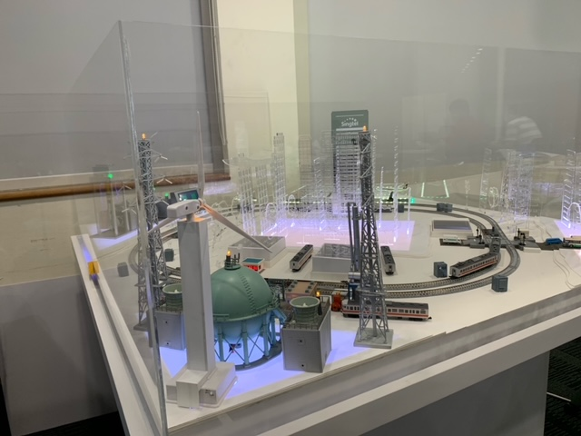
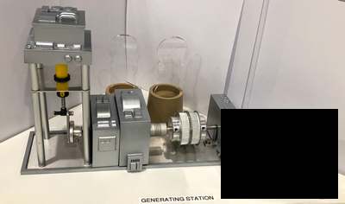
2.7 Create the fake generator turn off cmd to cut off the power supply
Technical PC
2.2 MS-Word document with embedded macrodocument from phishing email
2.1 Blackout Atk on cmd
IP: 192.168.10.251
2.4 Send atk active cmd
orchestrator PC
Attacker
(Raspberry PI)
1.1 False data injection Atk on cmd
IP: 192.168.10.90
2.3 Scan the network and fetch PLC information.
IP: 192.168.10.91
1.2 Reverse Runway light control and feedback signal data.
2.5 Block the network, feed fake data to HMI, turn off all the output of PLC
3.1 Stealthy Substation Attack
SCADA PC
OT Railway module
Modbus TCP/feedback cmd
IP: 192.168.10.21
3.2 Create unstable load feed back cmd from substation module
Generator 3D Module
Generator Controller (Raspberry PI)
Serial COM
Power
IP: 192.168.10.244
PLC IP: 192.168.10.71/72/73

Slide 2



orchestrator PC
SCADA PC
Technical PC
IP: 192.168.10.90
IP: 192.168.10.21
IP: 192.168.10.251
PLC 2 [S7-1200]
Station + sensor
Level crossing power
Resident LED
Generator Moto speed control idx0
Firewall
IP: 192.168.10.73
Generator Moto speed control idx1
Router
PLC 1 [M221]
Airport LED.
IP: 192.168.10.1
Power Plant
IP: 192.168.10.10
Industrial LED
Generator pump speed control idx0
IP: 192.168.10.72
Generator pump speed control idx1
PLC 3 [M221]
Fork turnout.
Track A power
Track B power
Attack device
(Raspberry PI)
Generator Controller (Raspberry PI)
Generator 3D Module
City LED
IP: 192.168.10.71
Inner Train position sensor’s set power
Outer Train position sensor’s set power
IP: 192.168.10.91
IP: 192.168.10.244

Slide 3
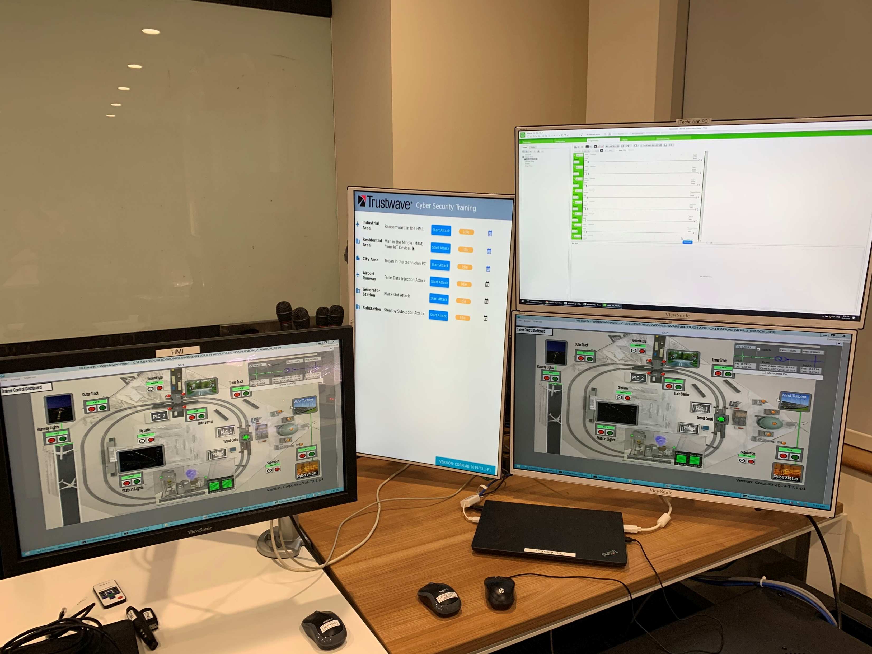
Technical PC
Orchestrator PC
SCADA HMI PC

Slide 4
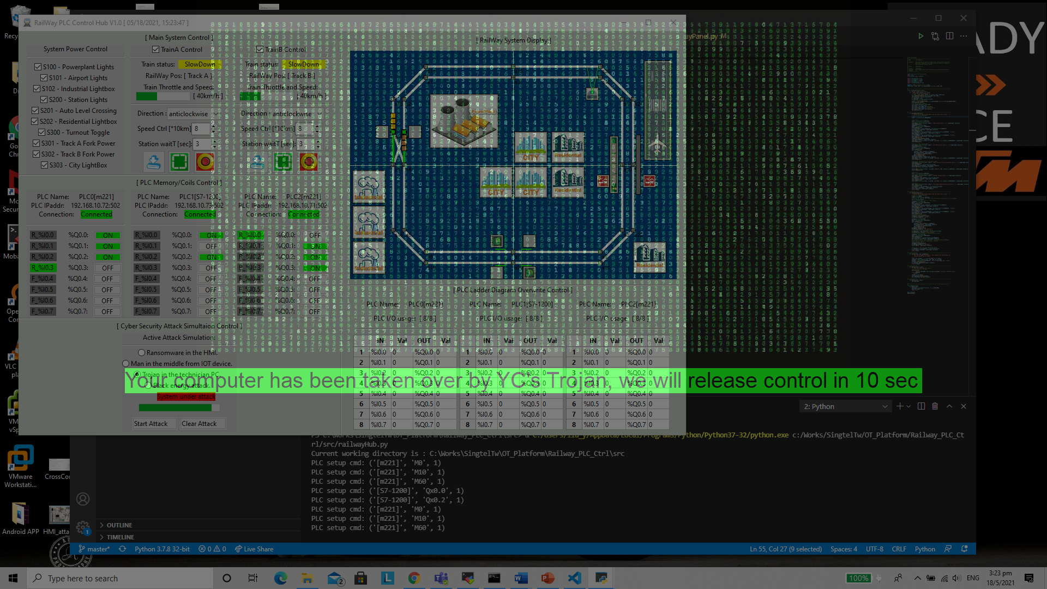

Slide 5
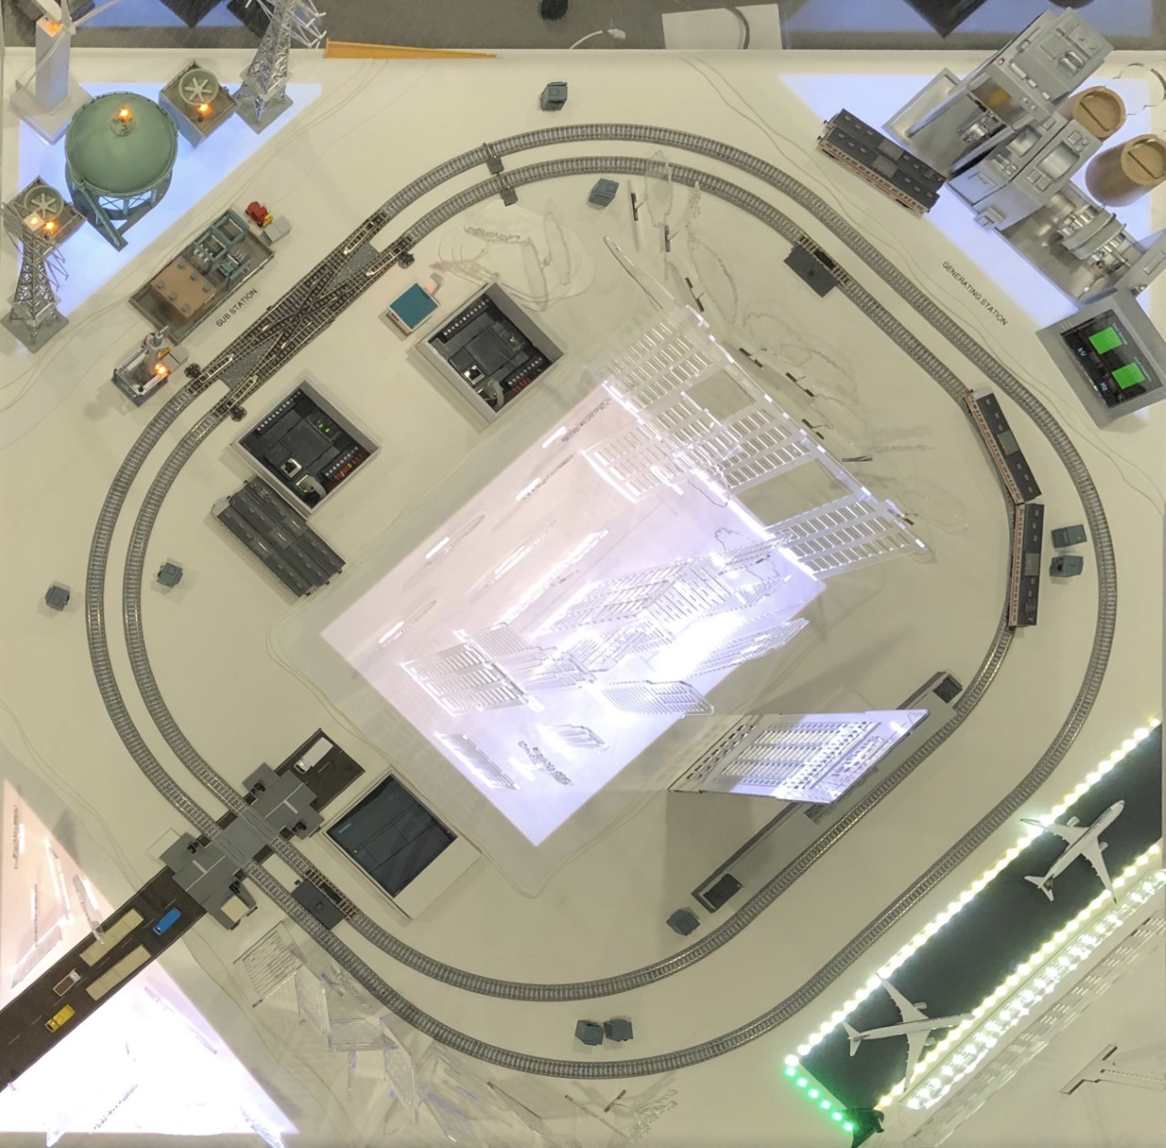
PLC3 M221 IP[192.168.10.73]
PLC1 M221 IP[192.168.10.71]
PLC2 S7-1200 IP[192.168.10.72]

Slide 6
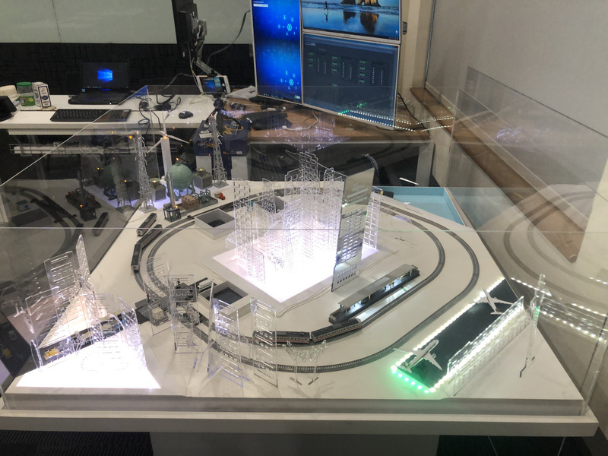
PLC1 M221 IP[192.168.10.71]
PLC3 M221 IP[192.168.10.73]
PLC2 S7-1200 IP[192.168.10.72]

Slide 7
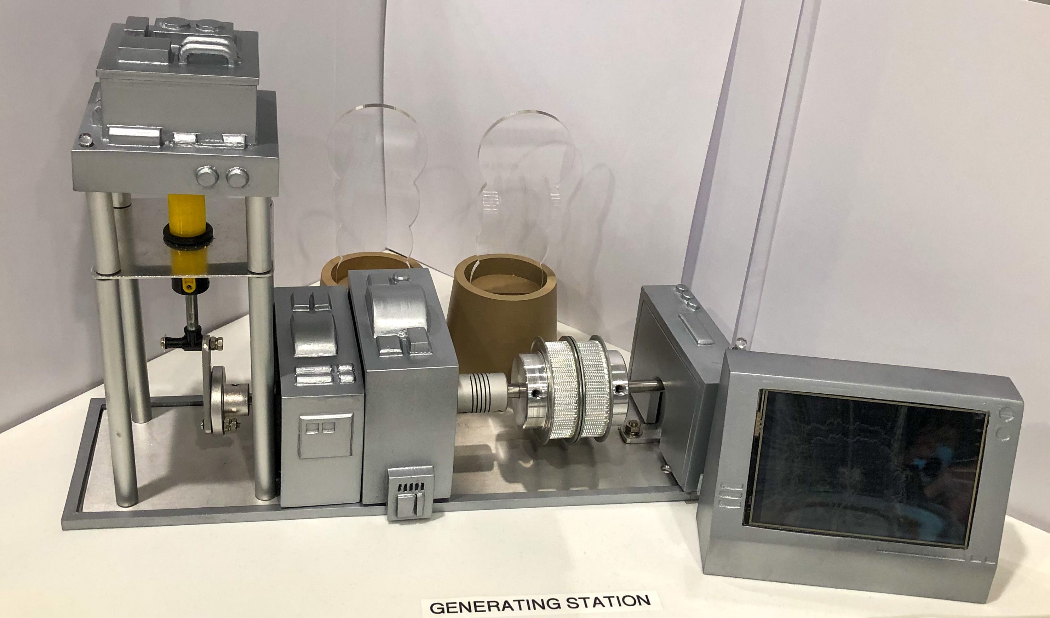
Substation LED Indicator
Generator output frequency and Voltage Display LCD Screen
Generator Fuel Pump
Generator Moto

